Slide 1



Department of CSE
Title of the Project:
Statistical Analysis and Distribution of Exam Result

Slide 2
Team Members & Mentors
Raisa Ghosh
Mr. Apurba Paul

Slide 3
Team Contact:
Sl. No | Name of the Students /Innovator | University Roll No. | College ID | Mobile Number | Mail Id
1 | RAISA GHOSH | 201230100110105 | JIS/2020/0297 | 8335976287 | raisaghoshbuisness@gmail.com

Slide 4
Problem Statement:
Analysis and graphical distribution of the exam results manually takes a takes up a lot of time and is very prone to error.

Slide 5
Idea towards Problem Solution: If we could make something that automatically does the searching and analysis in the backend and just gives the required result to the user when the user inputs the file/files to be analyzed, the process will not only be cost effective but also the accuracy rate will be close to 100%
Novelty of Idea:
The product if implemented on a large scale with a lot of functionalities can make the job of data analysis which takes days, something that can be done in a matter of seconds.

Slide 6
Project Abstract:
Result monitoring system
Performance Statistics for the last 5 or 10 years
Comparison of the performance of different year batches(subject-wise, gpa wise etc.)
Checking the total number of regular, lateral, backlog students appearing for an exam

Slide 7

Project Art Work/ Picture of Propose Solution :
The
Input
Screen

Slide 8

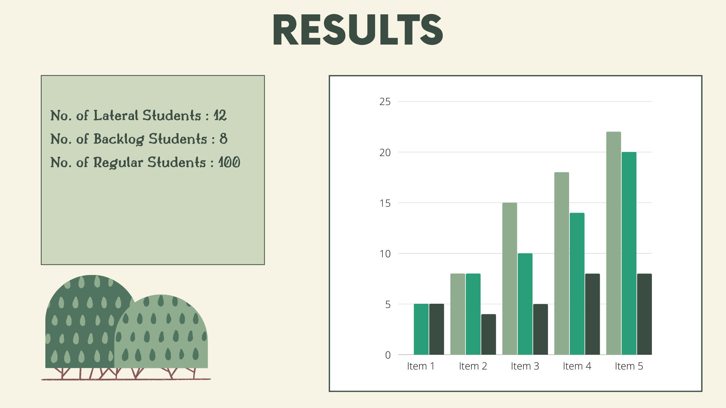
The Choice Screen
The Output Screen

Slide 9


Slide 10
Block Diagram or Processes Flow Diagram or Circuit Diagram Related to Project :
PROCESS OF MAKING AN APPLICATION WITH SOME FUNCTIONALITIES
STEP 2:
WRITING THE CODE TO PERFORM THE PARTICULAR TASK.
STEP 1:
THINKING OF VARIOUS KIND OF OPERATIONS THAT CAN BE DONE ON THE FILE.
2
1
STEP 3:
VERIFYING THE CODE USING DUMMY FILES.
STEP 4:
IMPLEMENTING THE TASK IN THE GUI SO THAT THE USER CAN USE IT.
3
4

Slide 11
FINAL APPLICATION WITH THE DIFFERENT FUNCTIONATIES
USER USING THE APPLICATION FOR VARIOUS KINDS OF ANALYSIS

Slide 12
Any Relevant Product/System Reported till Date :
NOT KNOWN TO ME.

Slide 13
Price Involved in Developing a Single Unit :
SL.No. | Items | Quantity | Rs. | Justification
Total

Slide 14
Outcome of the Project

Slide 15
Feasibility of Project in terms of prototype, product Development and Business application.

Slide 16
Anything other Information

Slide 17
Thank You

